Slide 1
Missing Parts (Back Orders) Dashboard in PowerBI
By Bruno Tortola
https://www.linkedin.com/in/brunotortola/
brunohtortola@gmail.com

Slide 2



Missing Parts Dashboard (BO)
In this presentation I’m going to show a dashboard I built in PowerBI that displays the status of missing parts (or back orders) in retail stores of an automotive company, as well as its monetary impact.

Slide 3
What is a missing part (BO)?
Automotive dealerships, transport companies or drivers can order parts to replace old or broken ones in their vehicles.
If all is well, the part is available either at the dealership, or at the main warehouse of the automotive company.
However, when this part is not readily available, and needs to be brought from other countries or locations, that is what we call a Missing Part, or Back Order

Slide 4
Goals of the Dashboard
Display the monetary impact of missing parts.
Display the amount of parts missing.
Run every 30 minutes with the latest updates.
Allow filters with product type, part origin, dealer, part numbers or part planner.

Slide 5
Technologies used
Power BI
Excel
Sharepoint
Power Automate Web
DAX
M
Power Query

Slide 6
Disclaimers
In order to preserve critical information of the company, some data had to be blanked out.
For the same reason, the original .pbix file cannot be shared, so I’m presenting it in PowerPoint format instead.

Slide 7
Dashboards and Charts

Slide 8
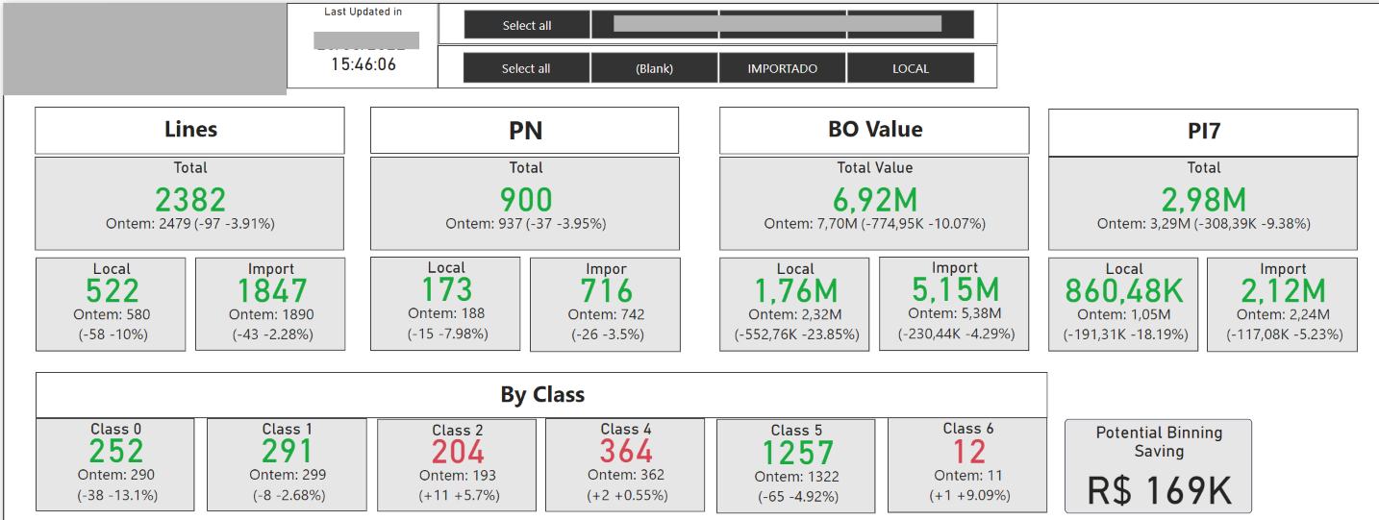
Overview
This section shows in KPI cards the amount of orders, values and lines, divided by local or import parts. Also shows the division by order class, and shows global filters at the top and the last updated time.

Slide 9
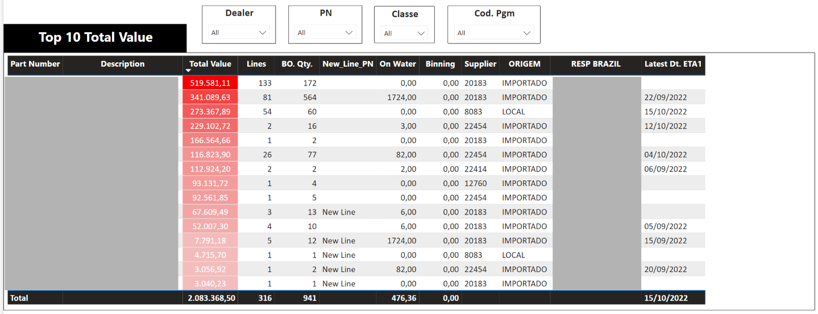
Top 10 by value
Here we can see the top 10 parts by their total value in back order, as well as some other relevant information

Slide 10
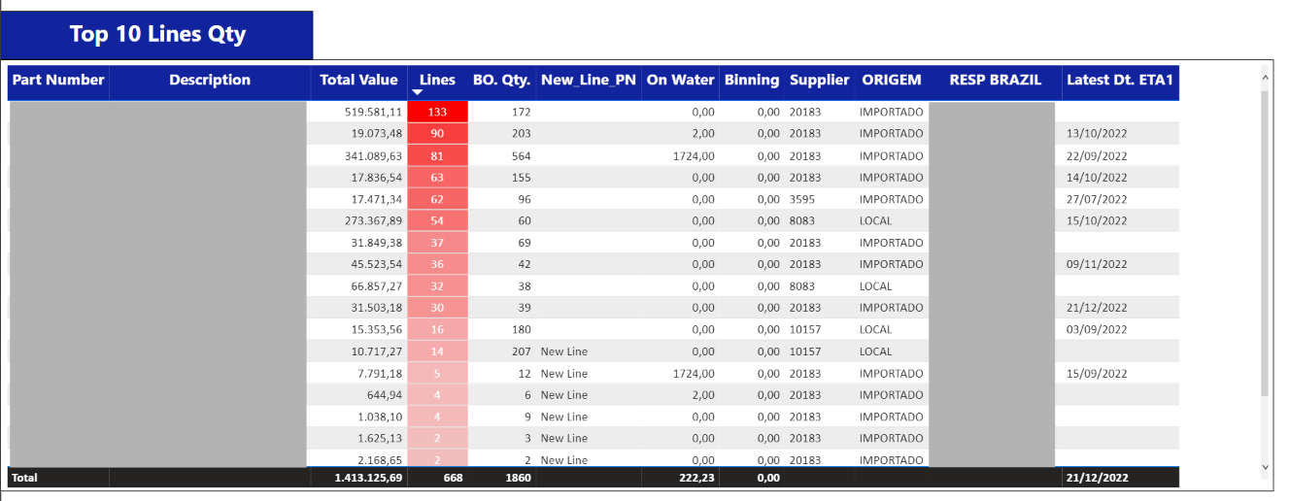
Top 10 by lines qty
Here we can see the top 10 part numbers by the amount of lines currently missing. Every line represent an order from a dealer.

Slide 11
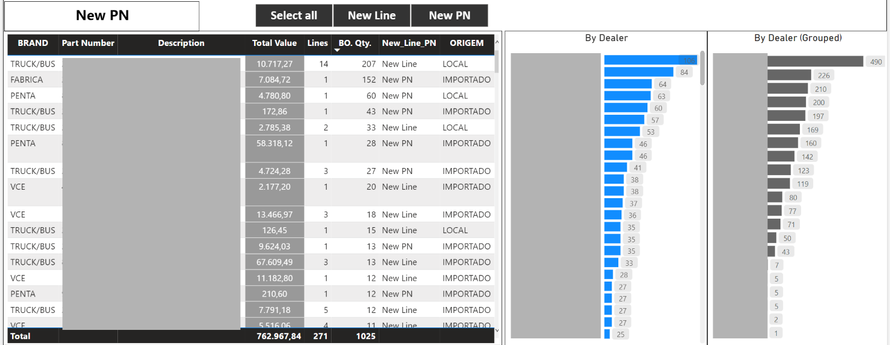
New lines and dealer distribution
Below is a table showing the new lines or new part numbers that arrived in the latest report. Also on the right a distribution of lines by the dealer name.

Slide 12
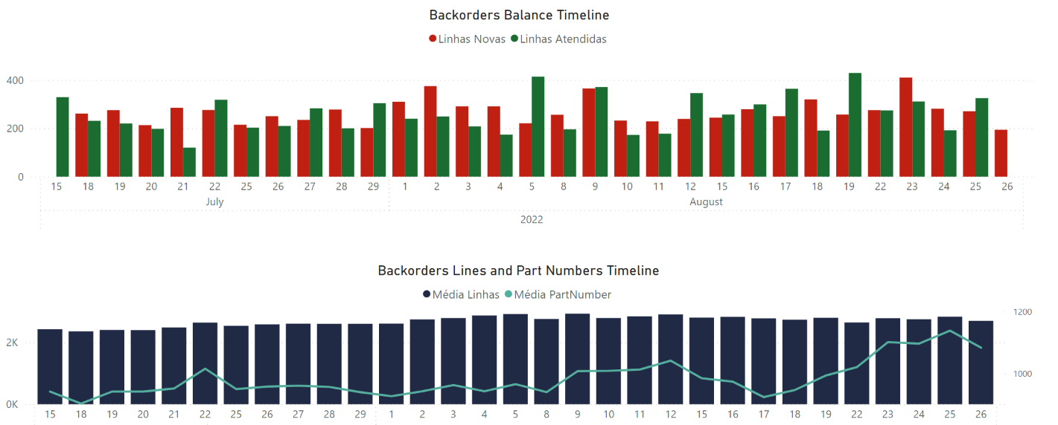
Timeline charts
The bar chart on the top shows in green the amount of lines that were fulfilled, and in red the new ones, from a daily point of view.
The chart on the bottom shows the average amount of lines on the bars and part numbers on the lines.

Slide 13
Schema and Datasets

Slide 14
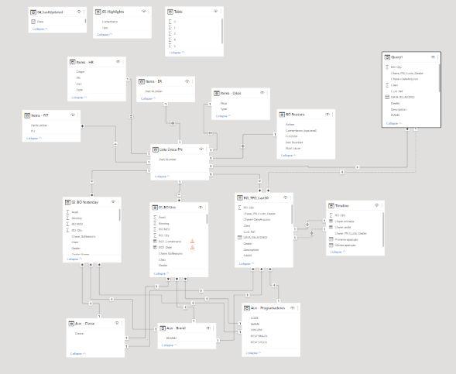
Datasets
This is a very complex dashboard. It currently 17 different datasets, all linked together. Below we can view it star schema.

Slide 15
DAX

Slide 16
DAX
DAX is the language used to make calculations in PowerBI, create specific measures and new columns. This dasbhoard has a lot of them, so I`m displaying below only some of them.

Slide 17
Power Query

Slide 18
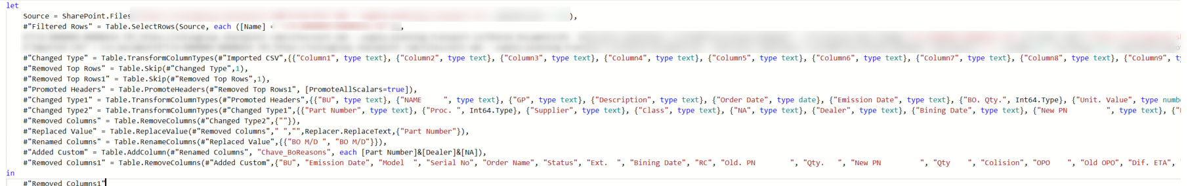
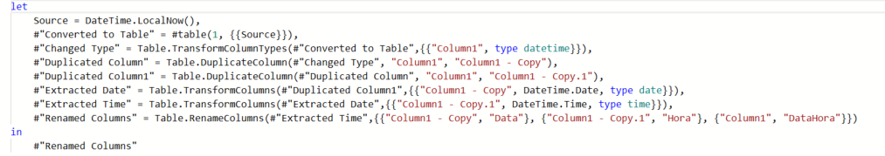
Power Query
Power Query is a pre-load process that we can apply to datasets in order to import data and clean it up before actually loading to PowerBI and start making charts.
Since this dashboard uses 17 different datasets, I`m going to display only some of the queries.
The query language is different than the formulas one. This one is called M.

Slide 19
Power Automate

Slide 20
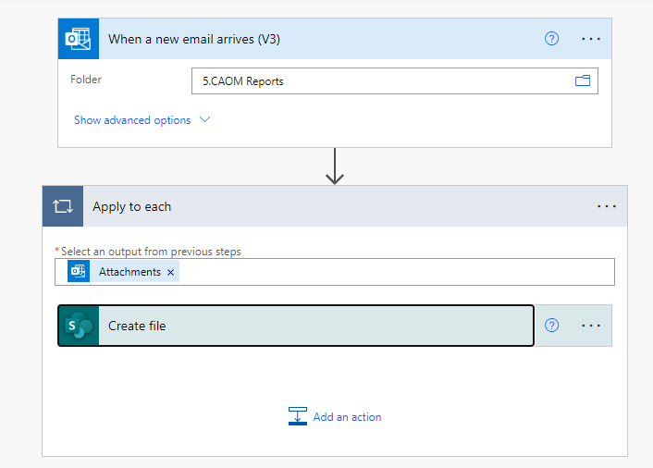
Power Automate Web
Some of the datasets arrive by email, every 30 minutes. I wrote a power automate flow to take those files from my email and save them to a sharepoint folder, in order to use them on the database.
The flow is really simple and effective, saving me the time it takes to download the files, saving them on an specific folder, replacing the old ones, etc.
The flow triggers everytime a new file arrives, so every 30 minutes.

Slide 21
Automated Refresh and Reports

Slide 22
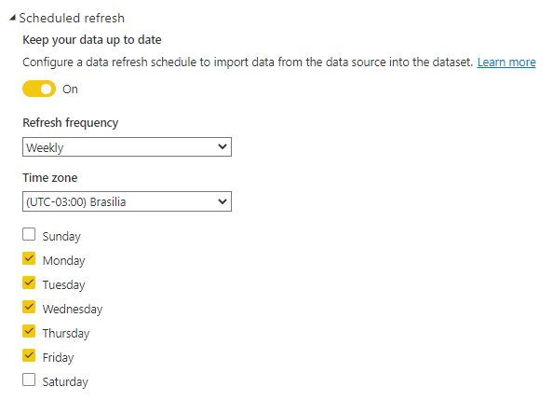
Automated Refresh
The dataset is refreshed daily on weekdays, every 30 min, and published to the Power BI online services. This updates all of the datasets and makes the latest version available for the stakeholders, all done automatically

Slide 23
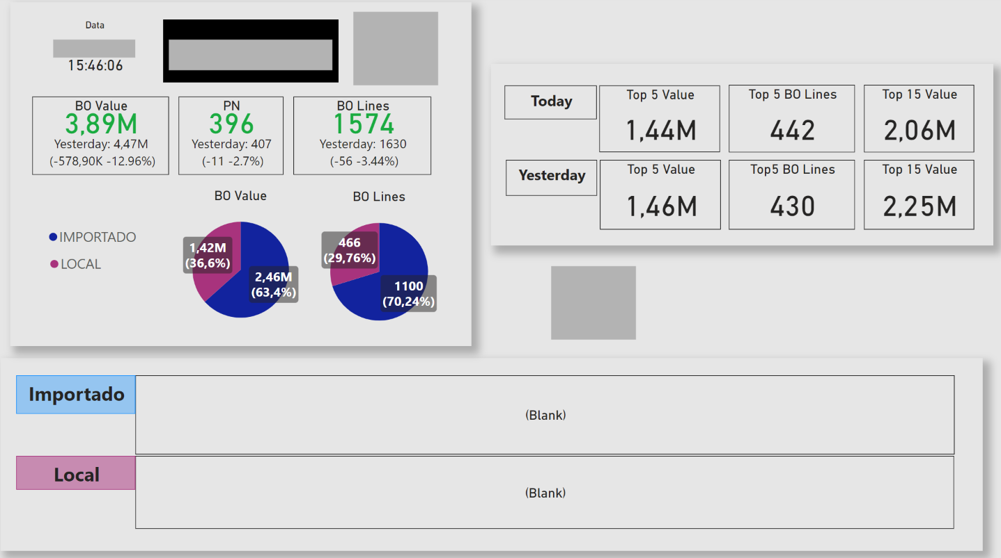
Daily sent summary
This dashboard is sent daily at 15:30 with the latest information to all stakeholders. This process is done automatically, via PowerBI subscription service.

Slide 24
Thanks for checking out my work!
Lets connect on LinkedIn!
https://www.linkedin.com/in/brunotortola/
brunohtortola@gmail.com

